Slide 1
2. Conditional Probability

Slide 2
Coins game
Toss 3 coins. You win if at least two come out heads.
S = { HHH, HHT, HTH, HTT, THH, THT, TTH, TTT }
W = { HHH, HHT, HTH, THH }

Slide 3
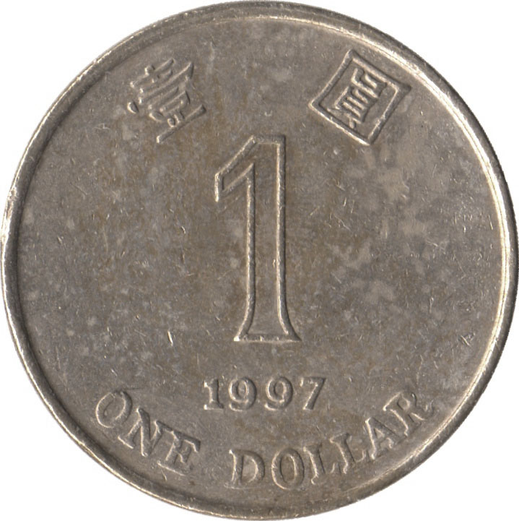
Coins game
The first coin was just tossed and it came out
tails. How does this affect your chances?
S = { HHH, HHT, HTH, HTT, THH, THT, TTH, TTT }
W = { HHH, HHT, HTH, THH }

Slide 4
Conditional probability
F
The conditional probability P(A | F) represents the probability of event A assuming event F happened.
S
A
Conditional probabilities with respect to the reduced sample space F are given by the formula
P(A ∩ F)
P(A | F) =
P(F)

Slide 5
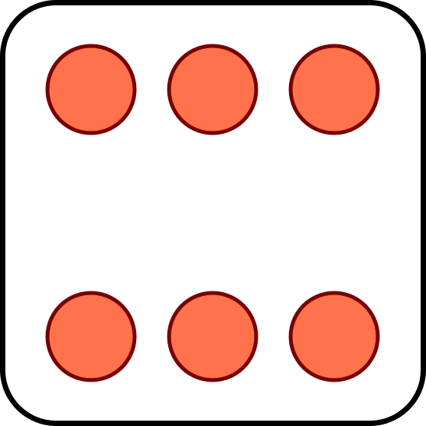

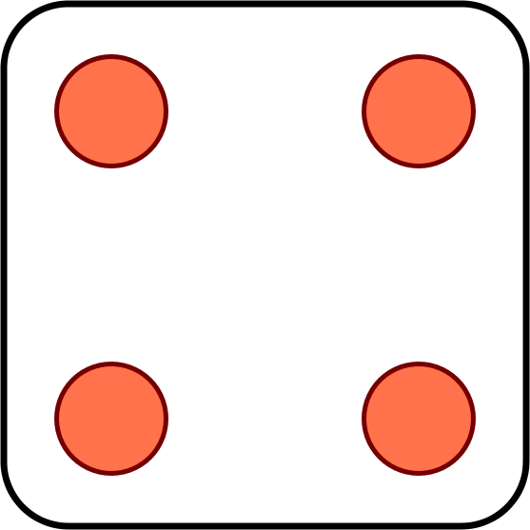

Toss 2 dice. You win if the sum of the outcomes is 8.
The first die toss is a 4. Should you be happy?
?

Slide 6
Now suppose you win if the sum is 7.
Your first toss is a 4. Should you be happy?

Slide 7
Properties of conditional probabilities
1. Conditional probabilities are probabilities:
P(F | F) = 1
P(A ∪ B | F) = P(A | F) + P(B | F) if disjoint
2. Under equally likely outcomes,
number of outcomes in A ∩ F
P(A | F) =
number of outcomes in F

Slide 8
Toss two dice. The smaller value is a 2. What is the probability that the larger value is 1, 2, …, 6?
11 12 13 14 15 16
21 22 23 24 25 26
31 32 33 34 35 36
41 42 43 44 45 46
51 52 53 54 55 56
61 62 63 64 65 66

Slide 9
You draw a random card and see a black side. What are the chances the other side is red?
A: 1/4
B: 1/3
C: 1/2

Slide 11

🇺🇸
🇨🇳
🇺🇸
🇨🇳
Serena
Williams
Qiang
Wang
Venus
Williams
Shuai
Zhang
P(Serena wins) = 2/3
P(Venus wins) = 1/2
P(🇨🇳 2: 🇺🇸 0) = 1/4
FINAL SCORE
🇨🇳
1
What is the probability
Serena won her game?
🇺🇸
1

Slide 13
The multiplication rule
P(E₁∩E₂)
Using the formula
P(E₂|E₁) =
P(E₁)
We can calculate the probability of intersection
P(E₁ ∩ E₂) = P(E₁) P(E₂|E₁)
In general
P(E₁∩…∩E_{n}) = P(E₁) P(E₂|E₁)…P(E_{n}|E₁∩… ∩ E_{n-1})

Slide 14
An urn has 10 white balls and 20 black balls. You draw two at random. What is the probability that both are white?

Slide 15
12 HK and 4 mainland students are randomly split into four groups of 4. What is the probability that each group has a mainlander?

Slide 16
Total probability theorem
F
F^{c}
P(E)
= P(EF) + P(EF^{c})
S
E
= P(E|F)P(F) + P(E|F^{c})P(F^{c})
F₃
F₁
F₄
More generally, if F₁,…, F_{n}
partition Ω then
E
F₂
F₅
P(E) = P(E|F₁)P(F₁) + … + P(E|F_{n})P(F_{n})

Slide 17
An urn has 10 white balls and 20 black balls. You draw two at random. What is the probability that their colors are different?

Slide 18
Multiple choice quiz
What is the capital of Macedonia?
A: Split
B: Struga
C: Skopje
D: Sendai
Did you know or were you lucky?

Slide 19
Multiple choice quiz
Probability model
There are two types of students:
Type K: Knows the answer
Type K^{c}: Picks a random answer
Event C: Student gives correct answer
P(C) = p = fraction of correct answers
p = P(C|K)P(K) + P(C|K^{c})P(K^{c})
= 1/4 + 3P(K)/4
1
1/4
1 - P(K)
P(K) = (p – ¼) / ¾

Slide 20
today
tomorrow
☀️
80% ☀️, 20% 🌧
🌧
40% ☀️, 60% 🌧
It is ☀️ on Monday. Will it 🌧 on Wednesday?

Slide 21
1
2
3
I choose a cup at random and then a random ball from that cup. The ball is red. You need to guess where the ball came from.
Which cup would you guess?

Slide 22
Cause and effect
1
2
3
cause:
C₁
C₂
C₃
effect:
R

Slide 23
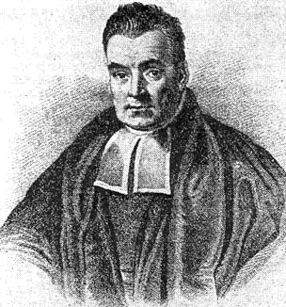
Bayes’ rule
P(E|C) P(C)
P(E|C) P(C)
P(C|E) =
=
P(E)
P(E|C) P(C) + P(E|C^{c}) P(C^{c})
More generally, if C₁,…, C_{n} partition S then
P(E|C_{i}) P(C_{i})
P(C_{i}|E) =
P(E|C₁) P(C₁) + … + P(E|C_{n}) P(C_{n})

Slide 24
Cause and effect
1
2
3
cause:
C₁
C₂
C₃
effect:
R
P(R|C_{i}) P(C_{i})
P(C_{i}|R) =
P(R|C₁) P(C₁) + P(R|C₂) P(C₂) + P(R|C₃) P(C₃)

Slide 25
Cause and effect
1
2
3
Ω =
P(C_{i}) =
P(R|C_{i}) =

Slide 26
Two classes take place in Lady Shaw Building.
ENGG2430 has 100 students, 20% are girls.
NURS3100 has 10 students, 80% are girls.
A girl walks out. What are the chances that she is from the engineering class?

Slide 27
Summary of conditional probability
Conditional probabilities are used:
1
When there are causes and effects
to estimate the probability of a cause when we observe an effect
2
To calculate ordinary probabilities
Conditioning on the right event can simplify the description of the sample space

Slide 28
Independence of two events
Let E₁ be “first coin comes up H”
E₂ be “second coin comes up H”
Then P(E₂ | E₁) = P(E₂)
P(E₂∩E₁) = P(E₂)P(E₁)
Events A and B are independent if
P(A∩B) = P(A) P(B)

Slide 29

Examples of (in)dependence
Let E₁ be “first die is a 4”
S₆ be “sum of dice is a 6”
S₇ be “sum of dice is a 7”
E₁ and S₆?
E₁ and S₇?
S₆ and S₇?
Notes:
0

Slide 30
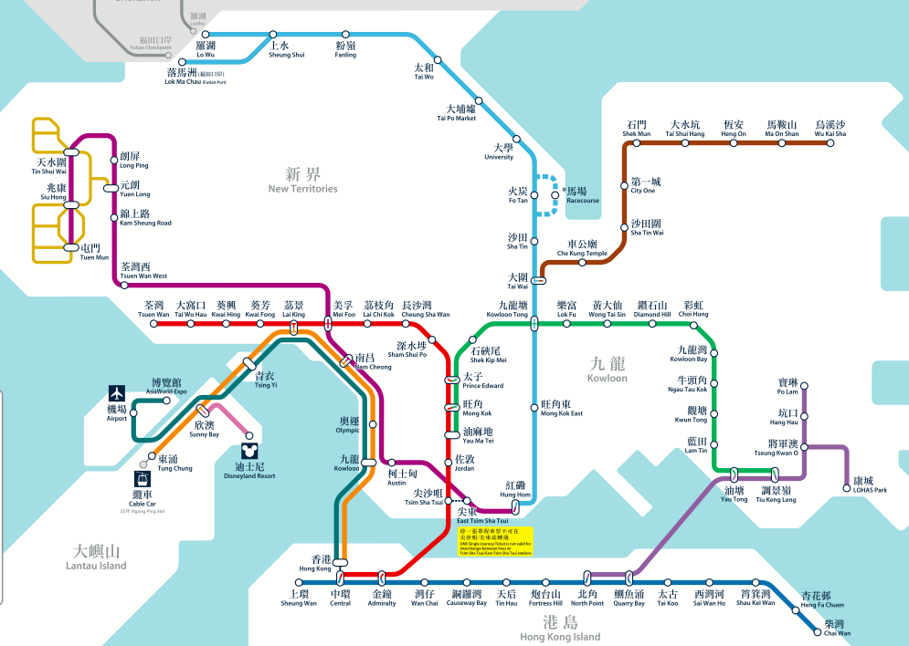
Sequential components
ER: “East Rail Line is working”
P(ER) = 70%
MS: “Ma On Shan Line is working”
P(MS) = 98%

Slide 31
Algebra of independent events
If A and B are independent, then A and B^{c} are also independent.
Proof:

Slide 32
Parallel components
TW: “Tsuen Wan Line is operational”
P(TW) = 80%
TC: “Tung Chung Line is operational”
P(TC) = 85%

Slide 33
Independence of three events
Events A, B, and C are independent if
P(A∩B) = P(A) P(B)
P(B∩C) = P(B) P(C)
P(A∩C) = P(B) P(C)
and P(A∩B∩C) = P(A) P(B) P(C).

Slide 34
(In)dependence of three events
Let E₁ be “first die is a 4”
E₂ be “second die is a 3”
S₇ be “sum of dice is a 7”
1/6
E₁, E₂?
E₁
E₁, S₇?
1/36
E₂
S₇
E₂, S₇?
1/6
1/6
E₁, E₂, S₇?

Slide 35
(In)dependence of three events
Let A be “first die is 1, 2, or 3 ”
B be “first roll is 3, 4, or 5”
S₇ be “sum of rolls is 9”
A, B?
A, C?
B, C?
A, B, C?

Slide 36
Independence of many events
Events A₁, A₂, … are independent if for every subset of the events, the probability of the intersection is the product of their probabilities.
Algebra of independent events
Independence is preserved if we replace some event(s) by their complements, intersections, unions

Slide 37
Multiple components
P(ER) = 70%
P(WR) = 75%
P(TW) = 85%
P(KT) = 95%

Slide 38
Multiple components
P(ER) = 70%
P(WR) = 75%
P(KT) = 95%
P(TW) = 85%

Slide 39

Playoffs
Alice wins 60% of her ping pong matches against Bob. They meet for a 3 match playoff. What are the chances that Alice will win the playoff?
Probability model
Let A_{i} be the event Alice wins match i
We assume P(A₁) = P(A₂) = P(A₃) = 0.6
We also assume A₁, A₂, A₃ are independent

Slide 40
Playoffs
outcome
probability
P(A) =

Slide 41
Bernoulli trials
n trials, each succeeds independently with
probability p
The probability at least k out of n succeed is

Slide 42
Playoffs
p = 0.6
p = 0.7
n
n
The probability that Alice wins an n game tournament

Slide 43
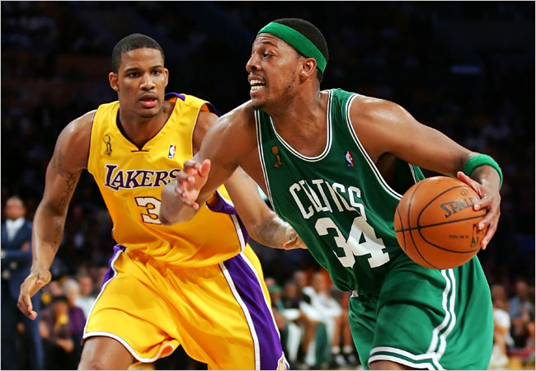
The Lakers and the Celtics meet for a 7-game playoff. They play until one team wins four games.
Suppose the Lakers win 60% of the time. What is the probability that all 7 games are played?

Slide 45
Conditional independence
A and B are independent conditioned on F if
P(A ∩ B | F) = P(A | F) P(B | F)
Alternative definition:
P(A | B ∩ F) = P(A | F)

Slide 46
Conditioning does not preserve independence
Let E₁ be “first die is a 4”
E₂ be “second die is a 3”
S₇ be “sum of dice is a 7”

Slide 47
Conditioning may destroy dependence

